Slide 1
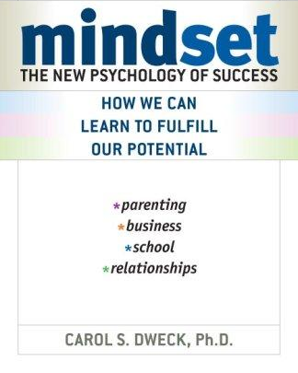

Slide 2
Two Views of Intelligence
Which mindset do you have?
Read each statement and decide whether you mostly agree with it or disagree with it.
You can learn new things, but you can’t really change how intelligent you are.
No matter how much intelligence you have, you can always change it quite a bit.
Notes:
Nature vs. Nurture debate – Answer in the middle
Ask for “agree most” number
Where are your students?
Picture high/low achieving students who might agree or disagree

Slide 3
Two mindsets

Slide 4
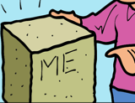
Two mindsets

Slide 5
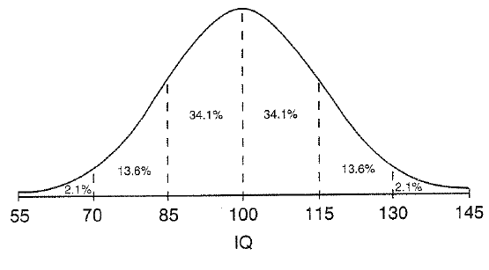
Fixed Mindset (Ability-based Belief)
Intelligence is:
FIXED
INNATE
UNEVENLY DISTRIBUTED
Notes:
Dominant Paradigm in our culture
Seen in popular culture – heroes all have extraordinary talent
Parable of the turtle and the hare.

Slide 6
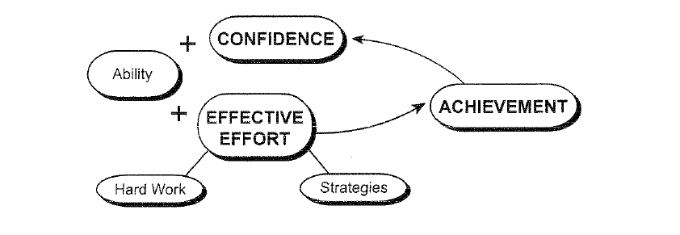
Growth Mindset (Effort-based Belief)
Notes:
Effective Effort is KEY WORD
Explain feedback loop
Don’t get too used to this graphic!

Slide 7
Growth Mindset - Positive Feedback Loop
Happiness
Motivation | Self-Confidence
Achievement
Time Spent on
Effective Effort
Expert Instruction
Strategic Hard Work
Image created by Kenny Iams at Lynbrook High School

Slide 8
There are many definitions of “Intelligence”
Agree
Disagree
No matter how much intelligence you have, you can always change it quite a bit.
Notes:
Nature vs. Nurture debate – Answer in the middle
Ask for “agree most” number
Where are your students?
Picture high/low achieving students who might agree or disagree

Slide 9
There are many definitions of “Intelligence”
Agree
Disagree
I can always change basic things about my personality and abilities.
Notes:
Nature vs. Nurture debate – Answer in the middle
Ask for “agree most” number
Where are your students?
Picture high/low achieving students who might agree or disagree

Slide 10
There are many definitions of “Intelligence”
Agree
Disagree
My talent in an area is something about me that I can change very much.
Notes:
Nature vs. Nurture debate – Answer in the middle
Ask for “agree most” number
Where are your students?
Picture high/low achieving students who might agree or disagree

Slide 11
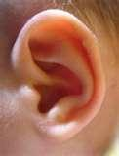
Evidence from Neuroscience
People who play music have been found to have auditory centres that are BIGGER than normal.
The ‘sound’ area of their brain grew through practicing their music.

Slide 12
The “Natural Ability” Myth…
Mathematics- “Logic Smart”
Albert Einstein's teacher said that he was ‘academically subnormal’
He failed the entrance exam to get into an elite college.
He spent two years looking for a teaching position, and nobody would hire him.

Slide 13
The “Natural Ability” Myth…
Kinesthetic – “Body Smart”
Michael Jordan's coach said that he wasn’t more talented than others…
He was cut from his freshman basketball team.

Slide 14
The “Natural Ability” Myth…
Visual – “Picture Smarts”
Walt Disney was told that he lacked “creative imagination.”
After the War, no newspaper would hire him as an cartoon artist.

Slide 15
Why does Mindset matter?
E
V
E
N
T
Fixed
Evidence about Ability
(Defines who you are)
Goal = Look Smart
Growth
Evidence about Progress
(Defines where you are)
Goal = Learn
Notes:
Event = Raise Hand, Write a paper, HW assignment, talking in class

Slide 16
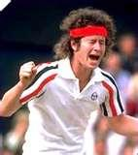
Failure: how do we respond to failure?

Slide 17
How do people respond?
F
A
I
L
U
R
E
Fixed
Helpless
Lose self-esteem
Make excuses
Growth
Opportunity
Look for lessons
Learn new strategies

Slide 18
Effort: What role does it play?

Slide 19
Why put forth Effort?
E
F
F
O
R
T
Fixed
Lack of Ability
Try hard only
if you ‘need to’
Growth
Path to Success
Bigger Challenge just
requires more effort

Slide 20
Created By: Josh Maisel Coordinator of Academic Interventions Fremont Union High School District Questions? josh_maisel@fuhsd.org
Adapted from: Mindset: The Psychology of Learning and Achievement
The Centre would like to thank the Scottish Government for their support in helping to produce this resource.

Slide 21
Online Sources
Mindset
Carol Dweck
Brainology
Research For Better Teaching
David Perkins
Print Sources
Dweck, Carol. Mindset: The New Psychology of Success. New York: Random House, 2006.
Perkins, David. Outsmarting IQ: The Emerging Science of Learnable Intelligence. New York: The Free Press, 1995.
Saphier, Jon, and Gower, Robert. The Skillful Teacher: Building Your Teaching Skills, Research for Better Teaching, Inc.: Action, MA, 1997.

